Slide 1
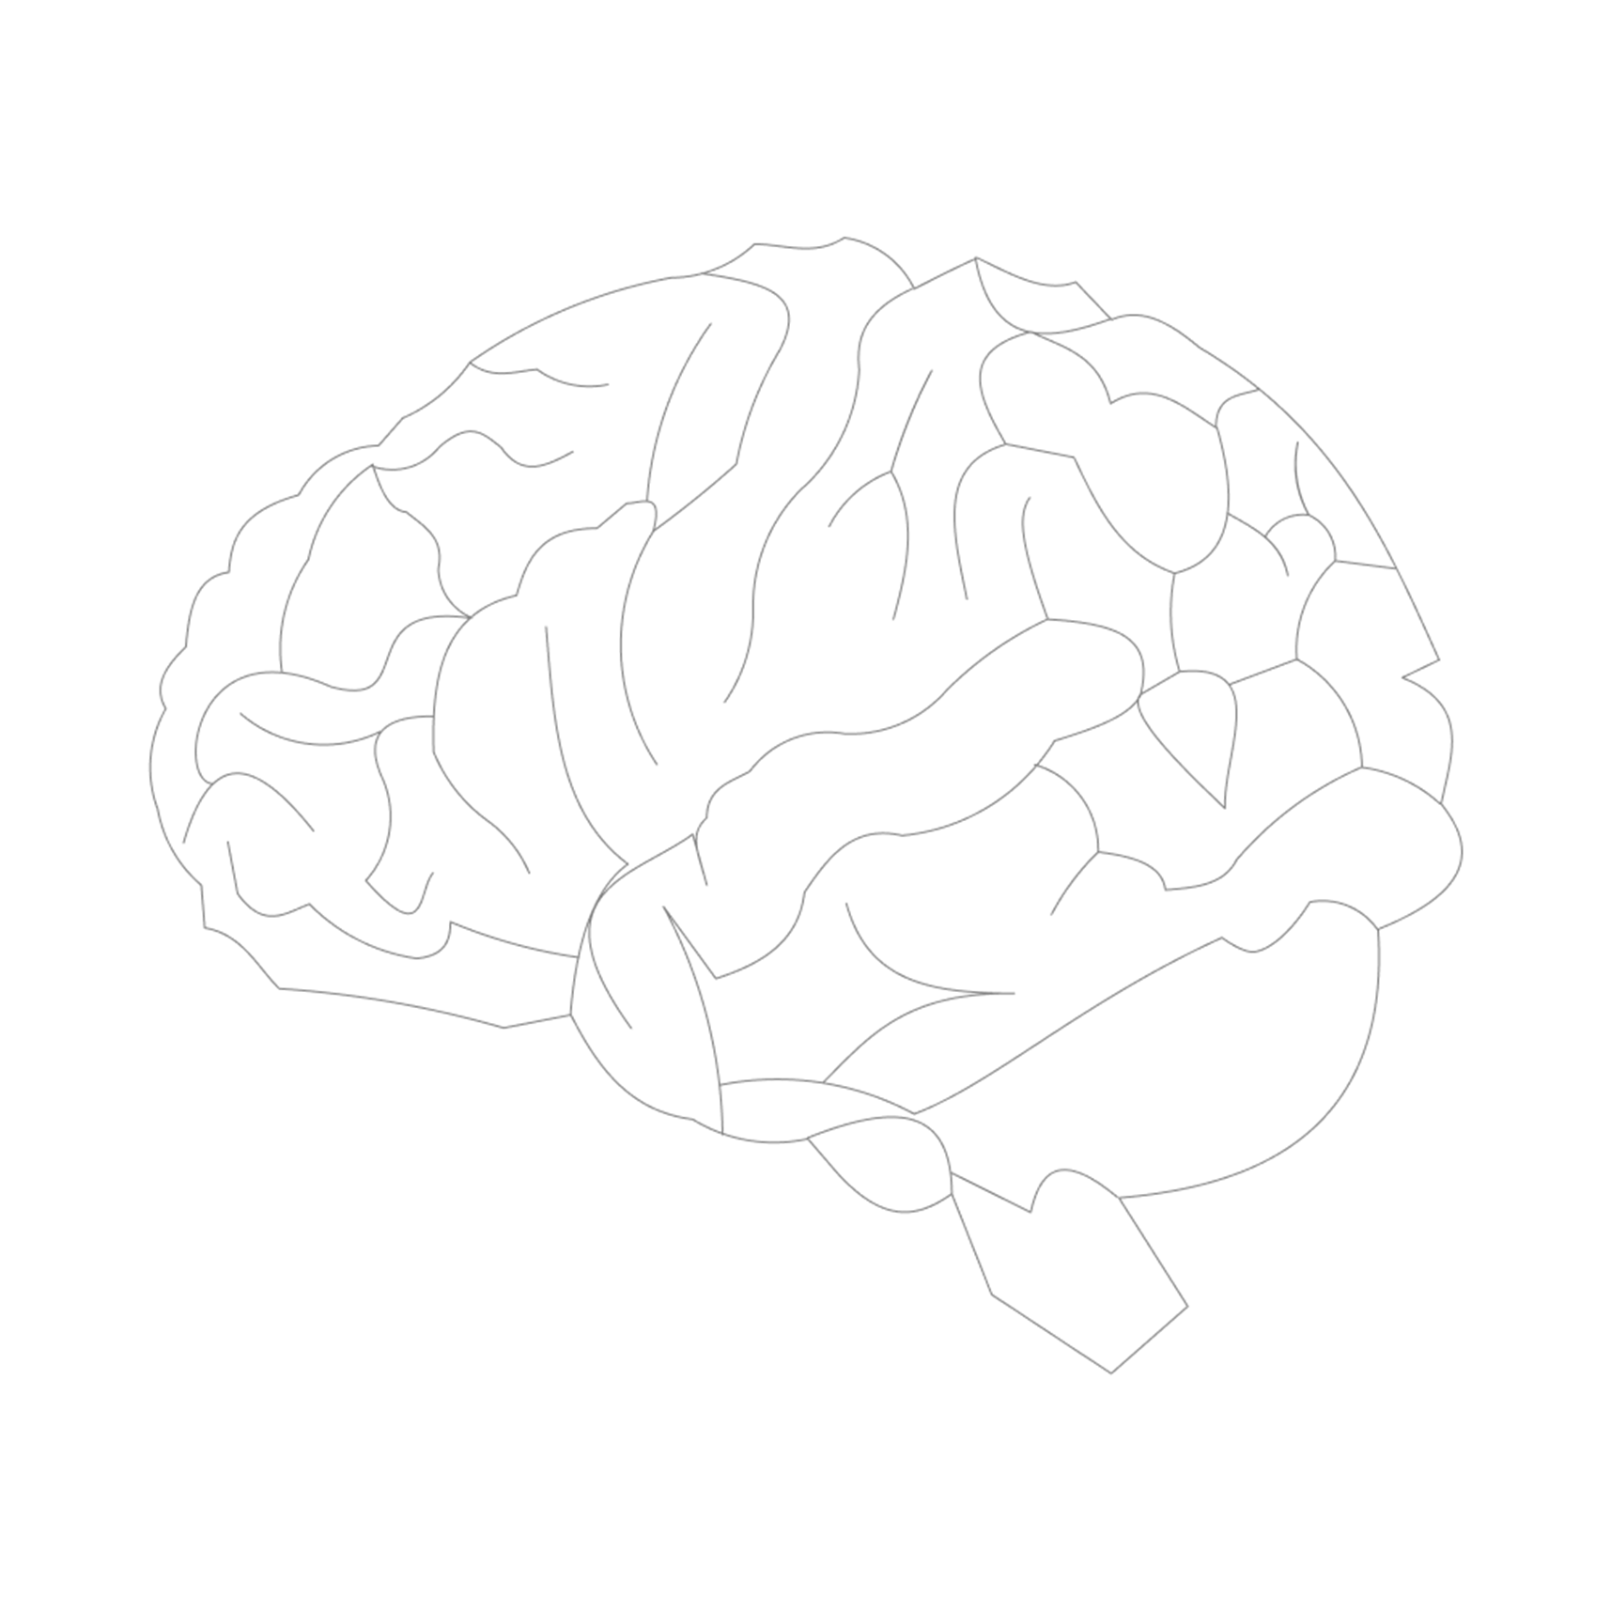
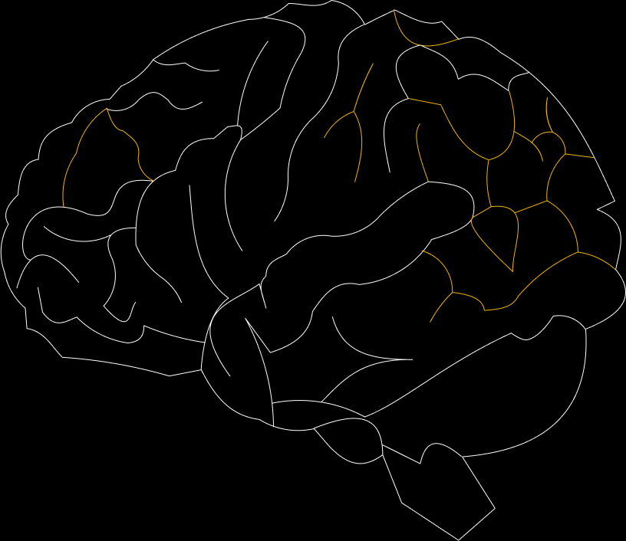

VISUALIZEIT

Slide 2






WHAT WE MADE
MADE BY
VISUALIZEIT

Slide 3

WHAT WE MADE
MADE BY
Sudeep
Sujan
VISUALIZEIT
Surav
PATHFINDER
Used Dijkstra’s and A* algorithm for pathfinding

Slide 4
MADE BY
WHAT WE MADE
PATHFINDER
Used Dijkstra’s and A* algorithm for pathfinding

Slide 5

WHAT WE MADE
NQueens
Used recursive backtracking for n-queens

Slide 6
WHAT WE MADE
Sudoku
Used recursive backtracking for Sudoku solver

Slide 7
WHAT WE MADE
Tower of Hanoi
Used concept of recursion for Tower of Hanoi

Slide 8
WHAT WE MADE
Tower of Hanoi
Used concept of recursion for Tower of Hanoi

Slide 9
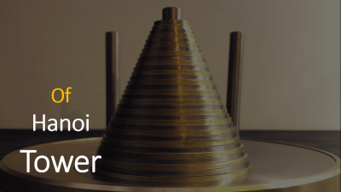

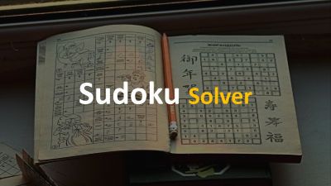

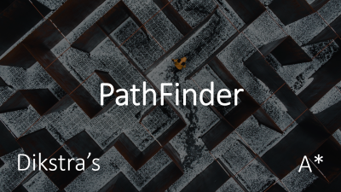


WHAT WE MADE
Tower of Hanoi
Used concept of recursion for Tower of Hanoi

Slide 10
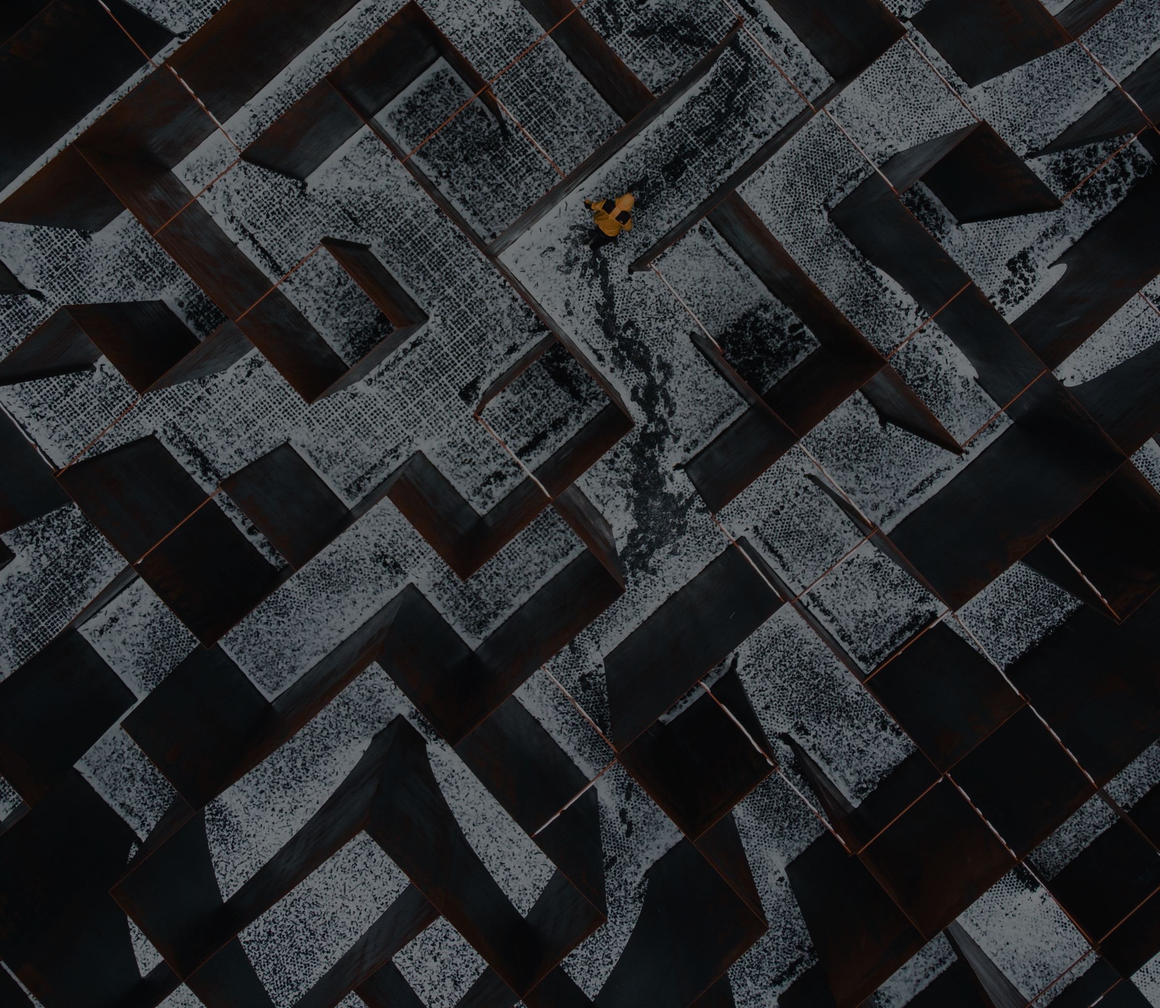
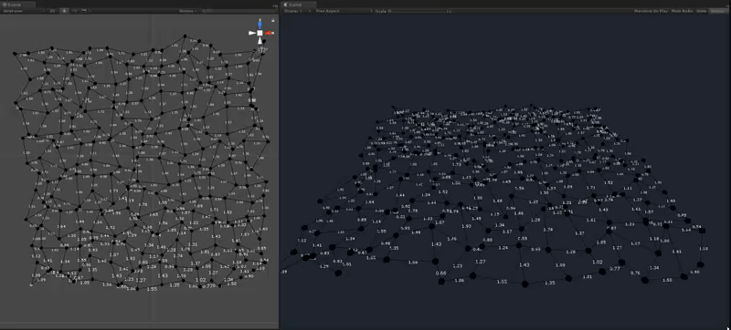
PathFinder
Dikstra’s
A*

Slide 11

PathFinder
Dijkstra’s Pathfinder
Dikstra’s
A*
Dijkstra’s algorithm finds the shortest path from a starting node to a target node in a grid.
We generated a maze using Depth first search recursive backtracking and used Dijkstra’s Algorithm to find the shortest path to reach our goal.

Slide 12

PathFinder
Dijkstra’s Pathfinder
Dikstra’s
A*
Dijkstra’s algorithm finds the shortest path from a starting node to a target node in a grid.
We generated a maze using Depth first search recursive backtracking and used Dijkstra’s Algorithm to find the shortest path to reach our goal.
A* Pathfinder
A* algorithm is an extension of Dijkstra's algorithm, and the only difference is that A* tries to look for a better path by using a heuristic function, which gives priority to nodes that are supposed to be better than others while Dijkstra's just explore all possible ways.

Slide 13


NQueens
Dijkstra’s Pathfinder
Dijkstra’s algorithm finds the shortest path from a starting node to a target node in a grid.
We generated a maze using Depth first search recursive backtracking and used Dijkstra’s Algorithm to find the shortest path to reach our goal.
A* Pathfinder
A* algorithm is an extension of Dijkstra's algorithm, and the only difference is that A* tries to look for a better path by using a heuristic function, which gives priority to nodes that are supposed to be better than others while Dijkstra's just explore all possible ways.

Slide 14
NQueens
A* Pathfinder
A* algorithm is an extension of Dijkstra's algorithm, and the only difference is that A* tries to look for a better path by using a heuristic function, which gives priority to nodes that are supposed to be better than others while Dijkstra's just explore all possible ways.
The N-Queens puzzle is the problem of placing n chess queens on an n×n chessboard so that no two queens attack each other.
We used Recursive Backtracking to place the queens in the positions where they are unable to attack each other.

Slide 15

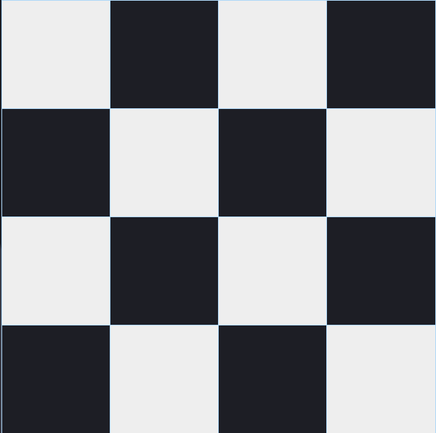
NQueens
The N-Queens puzzle is the problem of placing n chess queens on an n×n chessboard so that no two queens attack each other.
We used Recursive Backtracking to place the queens in the positions where they are unable to attack each other.

Slide 16

The N-Queens puzzle is the problem of placing n chess queens on an n×n chessboard so that no two queens attack each other.
We used Recursive Backtracking to place the queens in the positions where they are unable to attack each other.

Slide 17
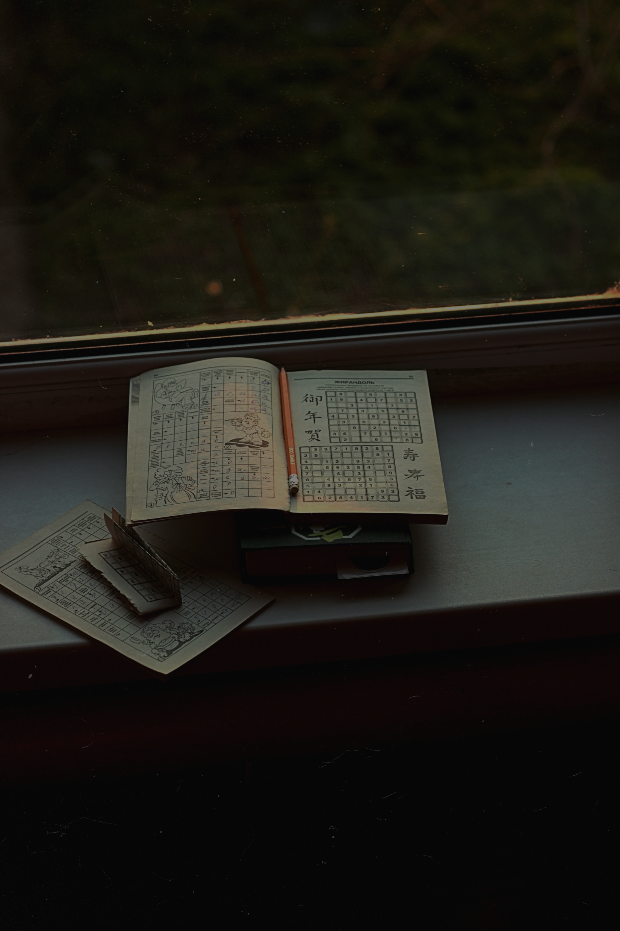
Sudoku Solver

Slide 18
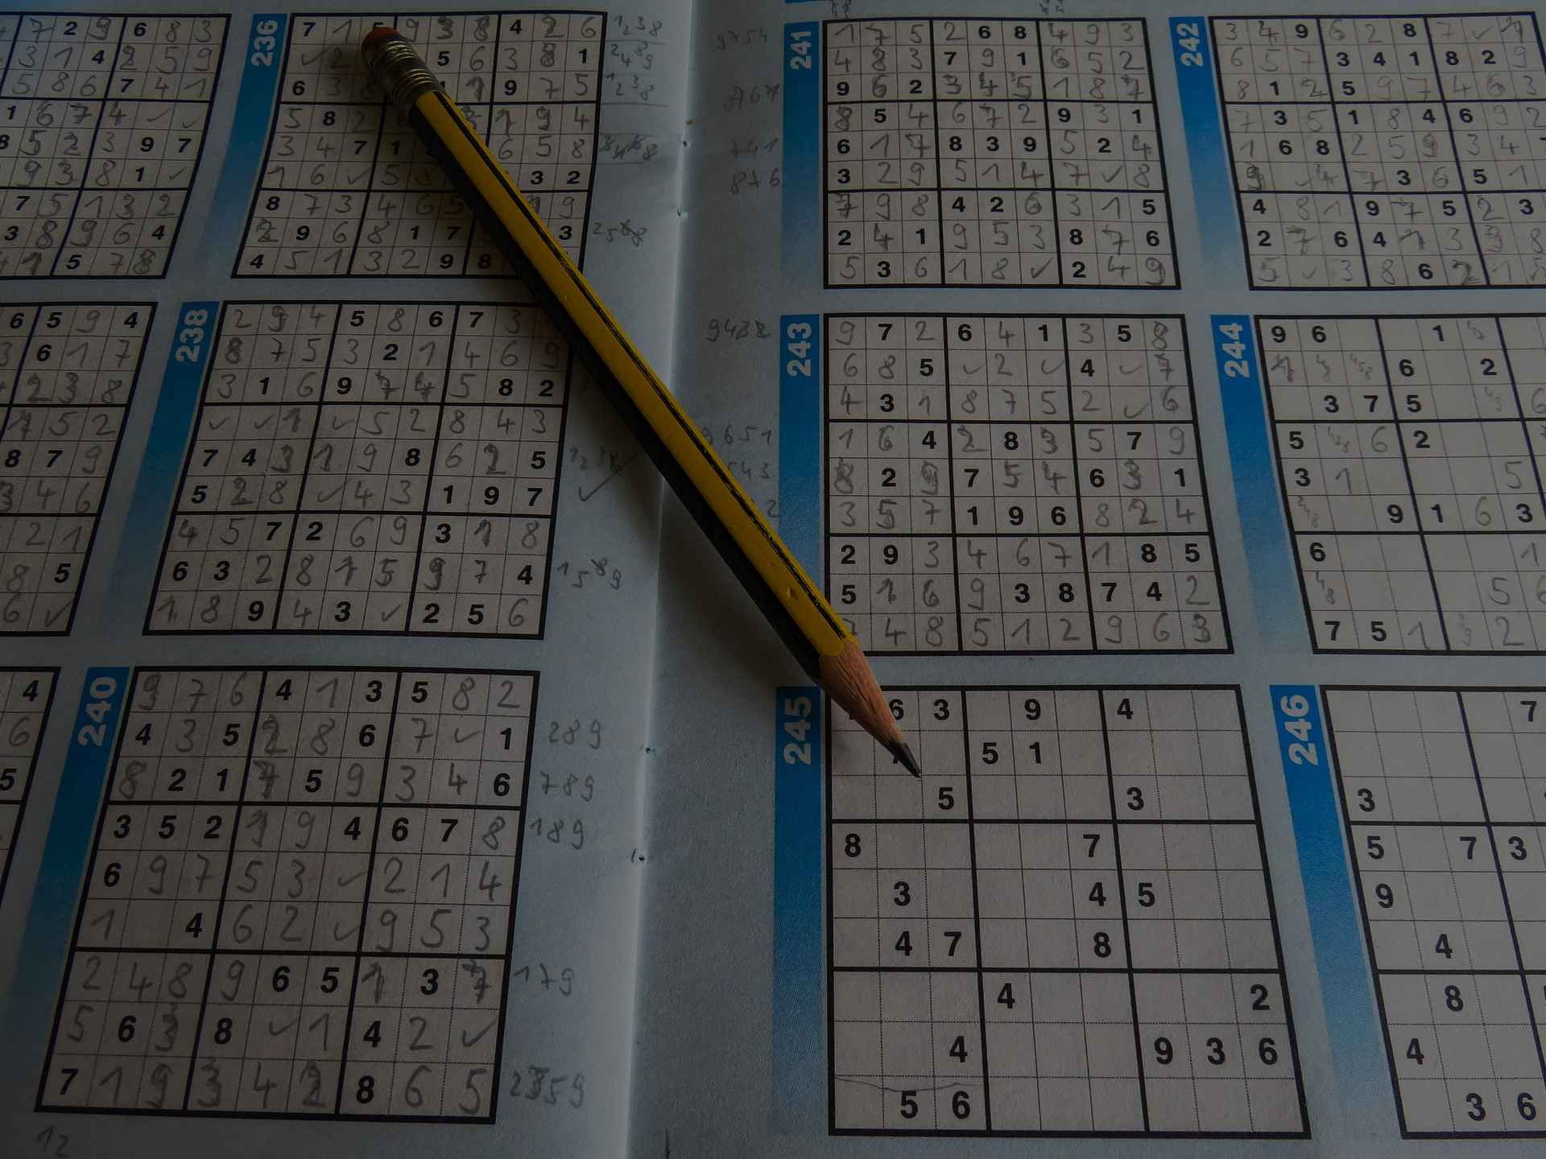
Using the Backtracking algorithm, we tried to solve the Sudoku problem. When some cell is filled with a digit, it checks whether it is valid or not. When it is not valid, it checks for other numbers. If all numbers are checked from 1-9, and no valid digit found to place, it backtracks to the previous option.
Sudoku Solver

Slide 19
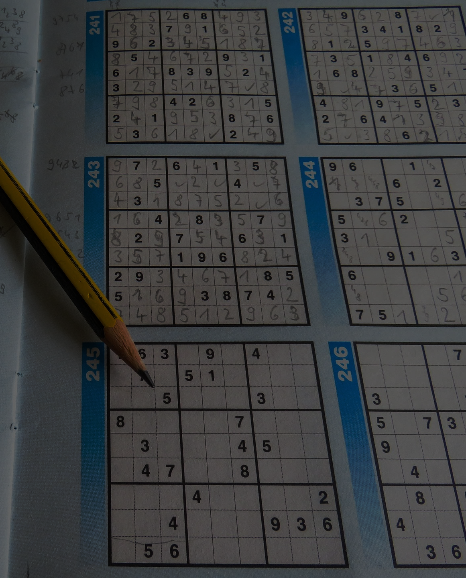
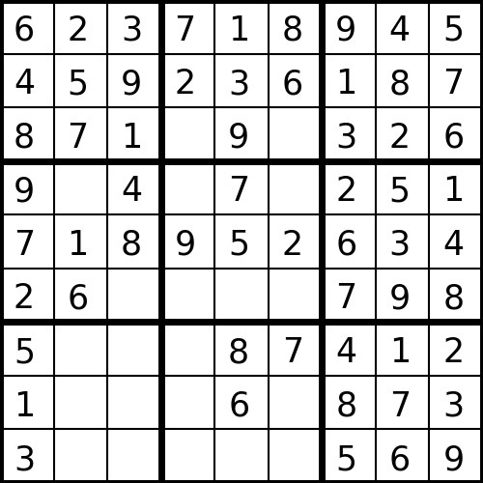
Using the Backtracking algorithm, we tried to solve the Sudoku problem. When some cell is filled with a digit, it checks whether it is valid or not. When it is not valid, it checks for other numbers. If all numbers are checked from 1-9, and no valid digit found to place, it backtracks to the previous option.
Sudoku Solver

Slide 20
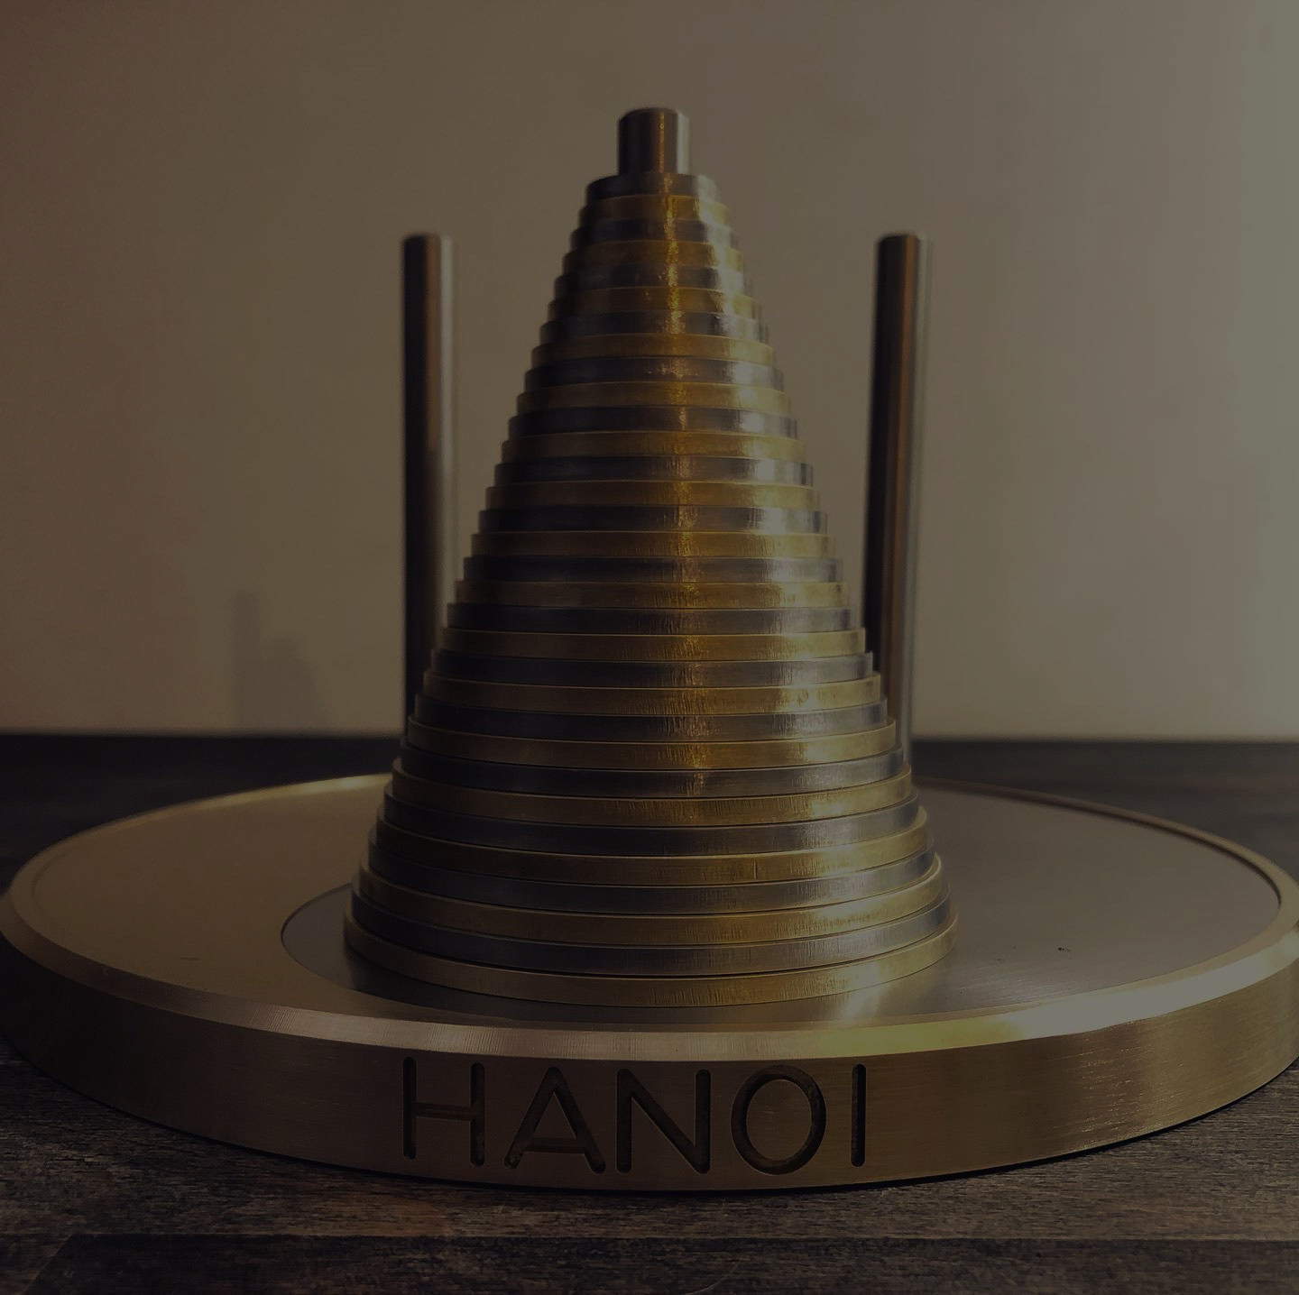
Using the Backtracking algorithm, we tried to solve the Sudoku problem. When some cell is filled with a digit, it checks whether it is valid or not. When it is not valid, it checks for other numbers. If all numbers are checked from 1-9, and no valid digit found to place, it backtracks to the previous option.
Of
Hanoi
Tower

Slide 21
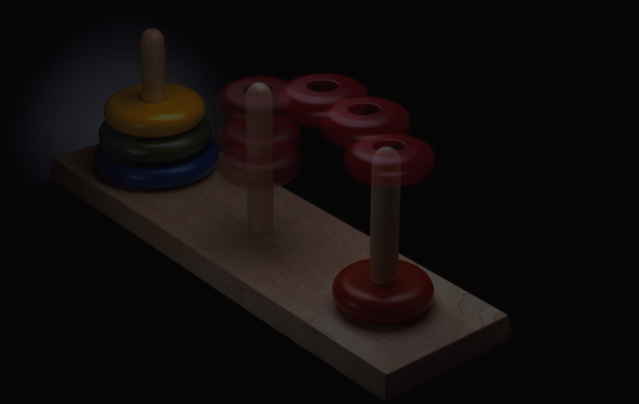
The Tower of Hanoi puzzle starts with a tower of disks of decreasing size stacked in order on one pole, with the largest disk at the bottom and the smallest at the top.
We used Recursion to move the discs such that the larger discs are never over the smaller discs during the process.
Of
Hanoi
Tower

Slide 22





The Tower of Hanoi puzzle starts with a tower of disks of decreasing size stacked in order on one pole, with the largest disk at the bottom and the smallest at the top.
We used Recursion to move the discs such that the larger discs are never over the smaller discs during the process.
Of
Hanoi
Tower

Slide 23

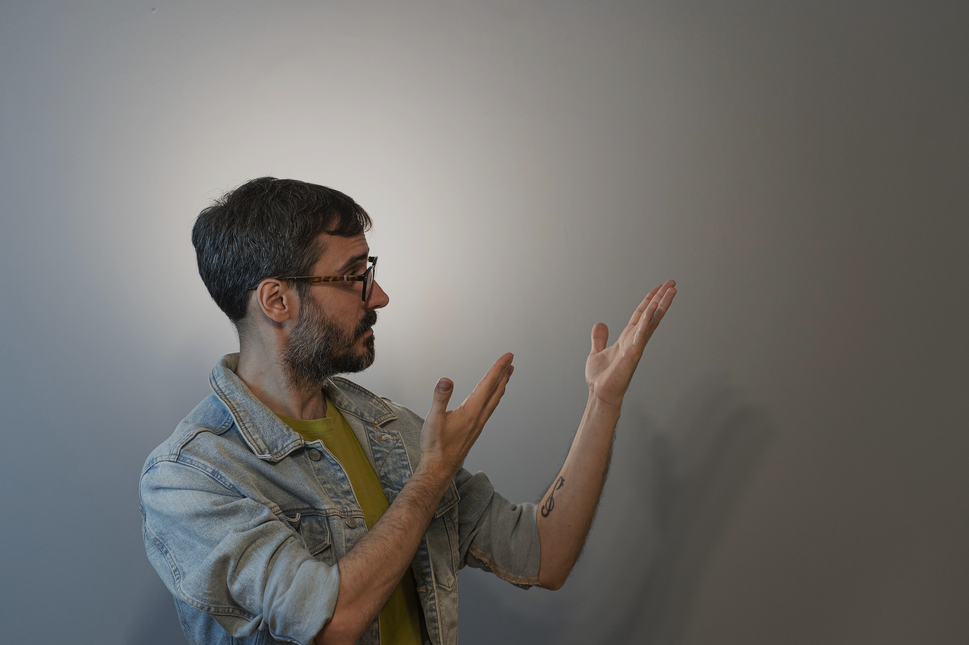
The Tower of Hanoi puzzle starts with a tower of disks of decreasing size stacked in order on one pole, with the largest disk at the bottom and the smallest at the top.
We used Recursion to move the discs such that the larger discs are never over the smaller discs during the process.

Slide 24
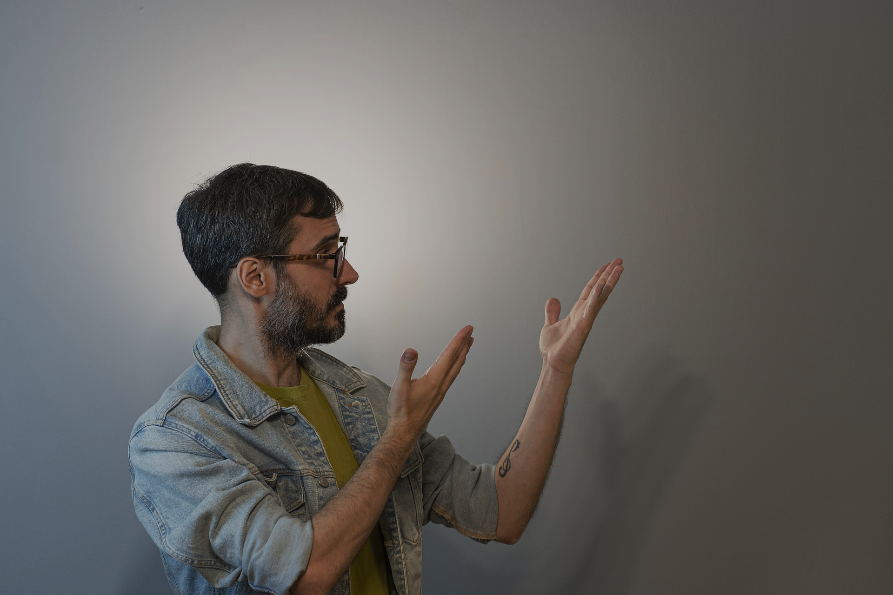

DEMO
The Tower of Hanoi puzzle starts with a tower of disks of decreasing size stacked in order on one pole, with the largest disk at the bottom and the smallest at the top.
We used Recursion to move the discs such that the larger discs are never over the smaller discs during the process.

